Slide 1


OLACABS
PREPARED BY-
AGAMPREET SINGH
MANSUKH KAUR
KUMARI SUMAN

Slide 2

INTRODUCTION
Ola cabs offers the easiest & fastest way to book a ride. With more than 3,00,000 cabs & taxis in 100+ cities including Bangalore, Chennai, Delhi, Mumbai, Hyderabad, Kolkata, Pune, Jaipur, & Ahmedabad, Ola is the most popular cab booking service in India.
M

Slide 3
ASSUMPTIONS
Locations are entered in pincode format only.
Only five locations of Delhi city are considered.
User will find a ride only when driver driving the car of desired service type has location similar to customer’s pincode.
We have assumed the distance between two locations and this distance is not realistic.
Cancellation charges are not considered.
If ride is not found, it is considered cancelled.

Slide 4

Entities in EER diagram
Driver
Customer
Car
Ride
Ridefinder
Service table
Distance
Driver details

Slide 5

EER-Model

Slide 6
Need for EER-diagram
EER diagram was required in this case because booked ride, ongoing ride, cancelled ride and completed ride are specialised entities of ride entity.

Slide 7
Relational schema for ER diagram and EER diagram

Slide 8
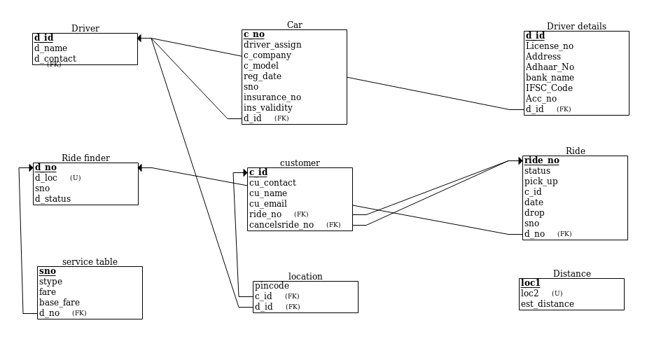

Slide 9
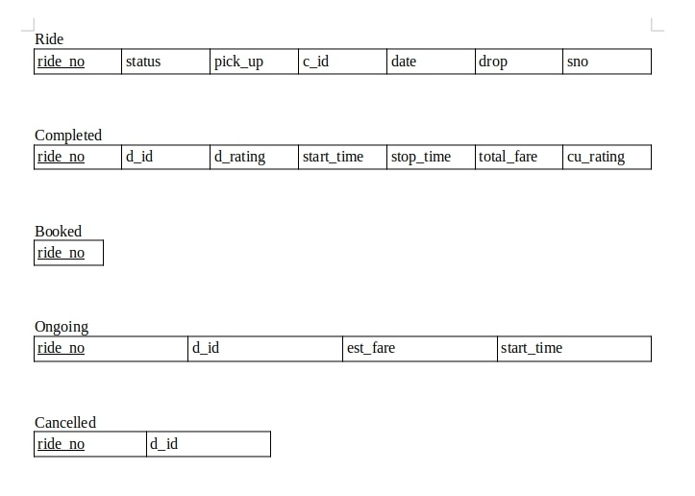
EER RELATIONAL SCHEMA

Slide 10
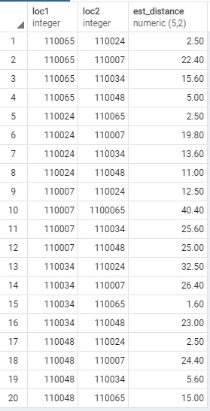
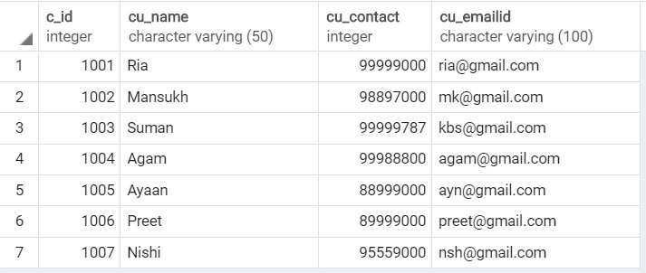
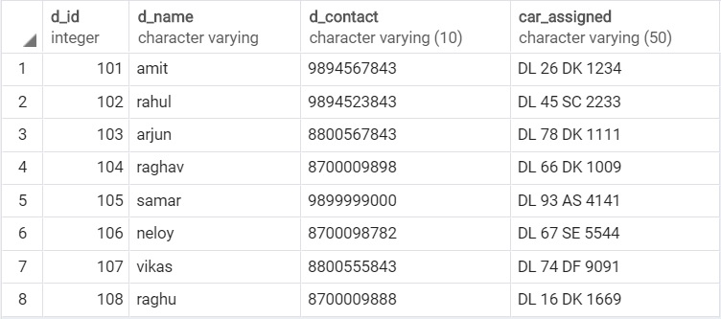
Tables

Slide 11
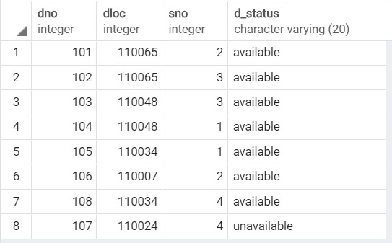
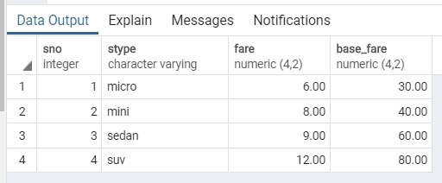
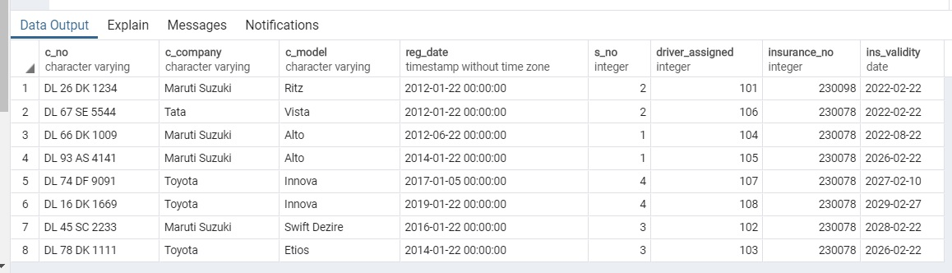

Slide 12
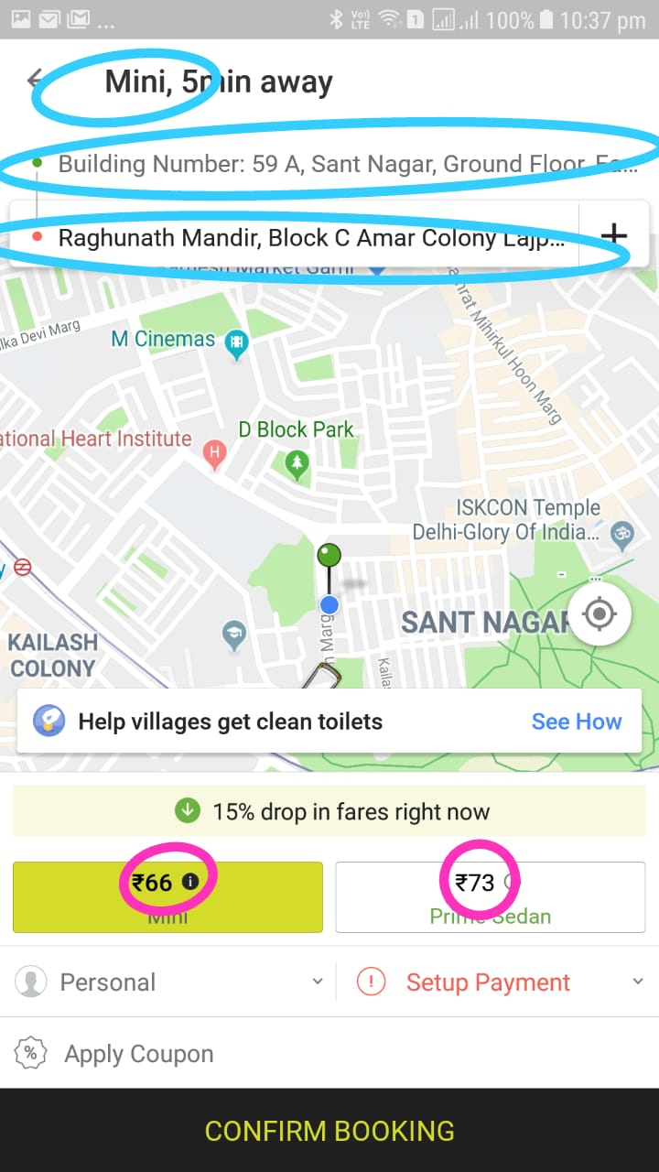
Booking A Ride
insert into ride (pickup, dropp,status ,c_id,sno, ride_date) values(110048,110007,'booked',1006,2,'23/04/2019');
insert into booked (ride_no) values(12);
select dno from ridefinder rf,ride r where r.ride_no=12 and r.sno=rf.sno and r.pickup=rf.dloc and rf.d_status ='available' ;
select s.base_fare+s.fare* d.est_distance as est_fare from distance d, ride r,services s where r.ride_no=1 and r.dropp=d.loc2 and r.pickup=d.loc1 and r.sno =s.sno ;

Slide 13
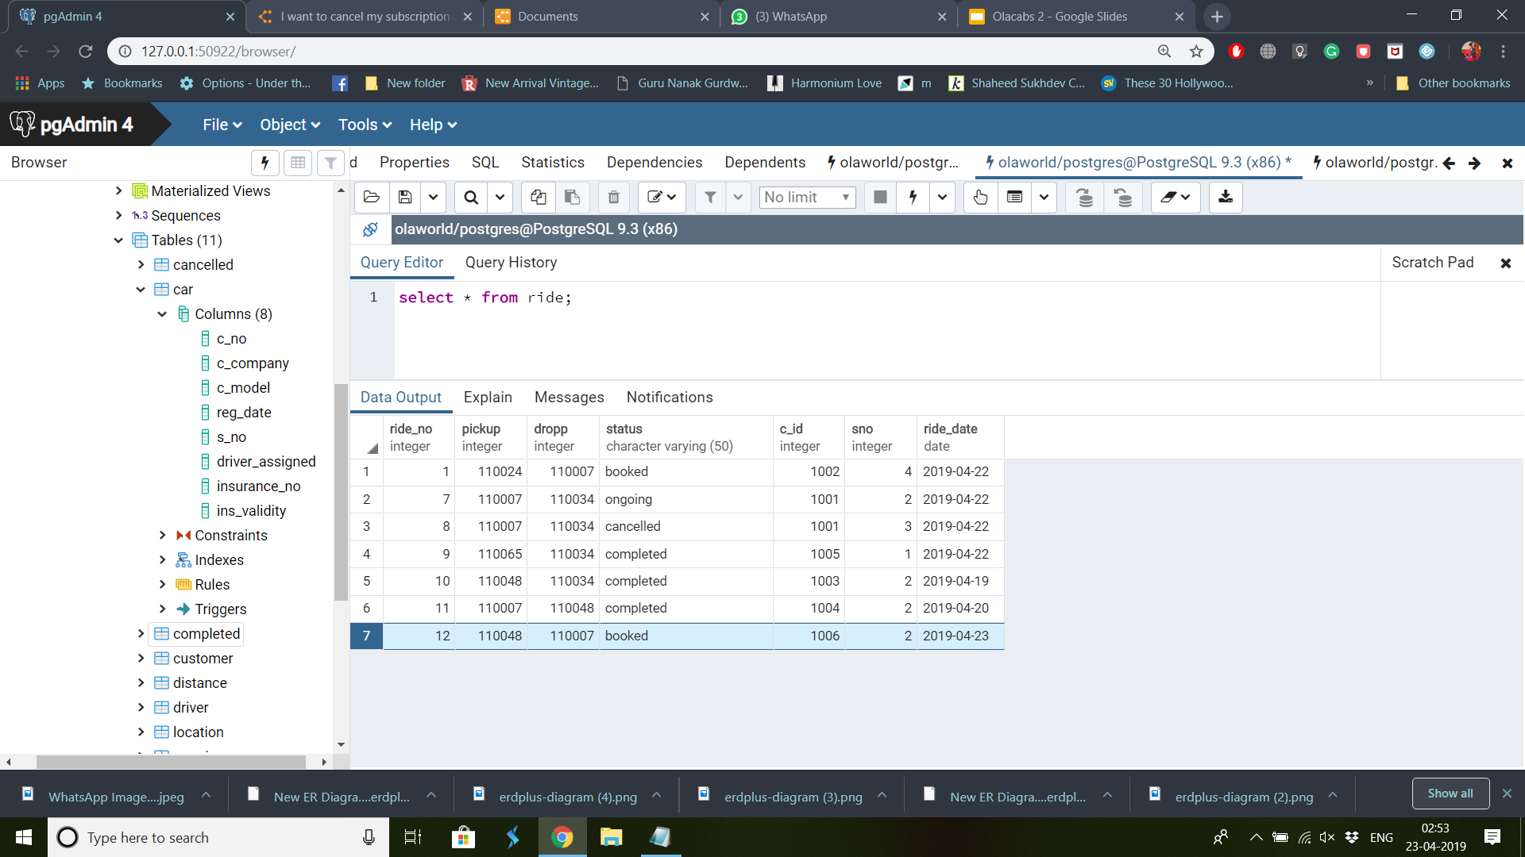
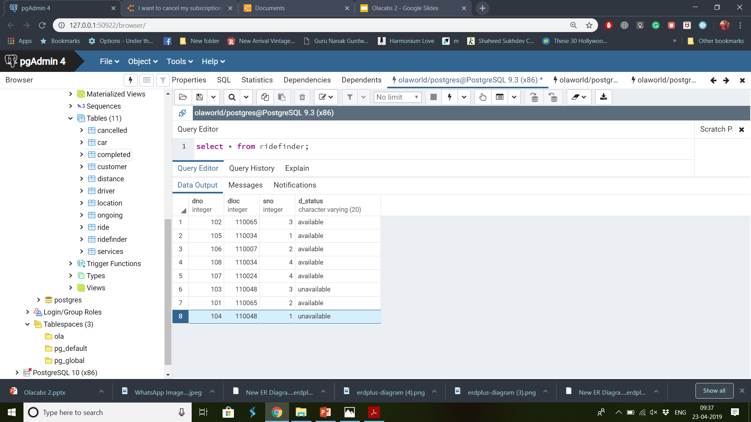
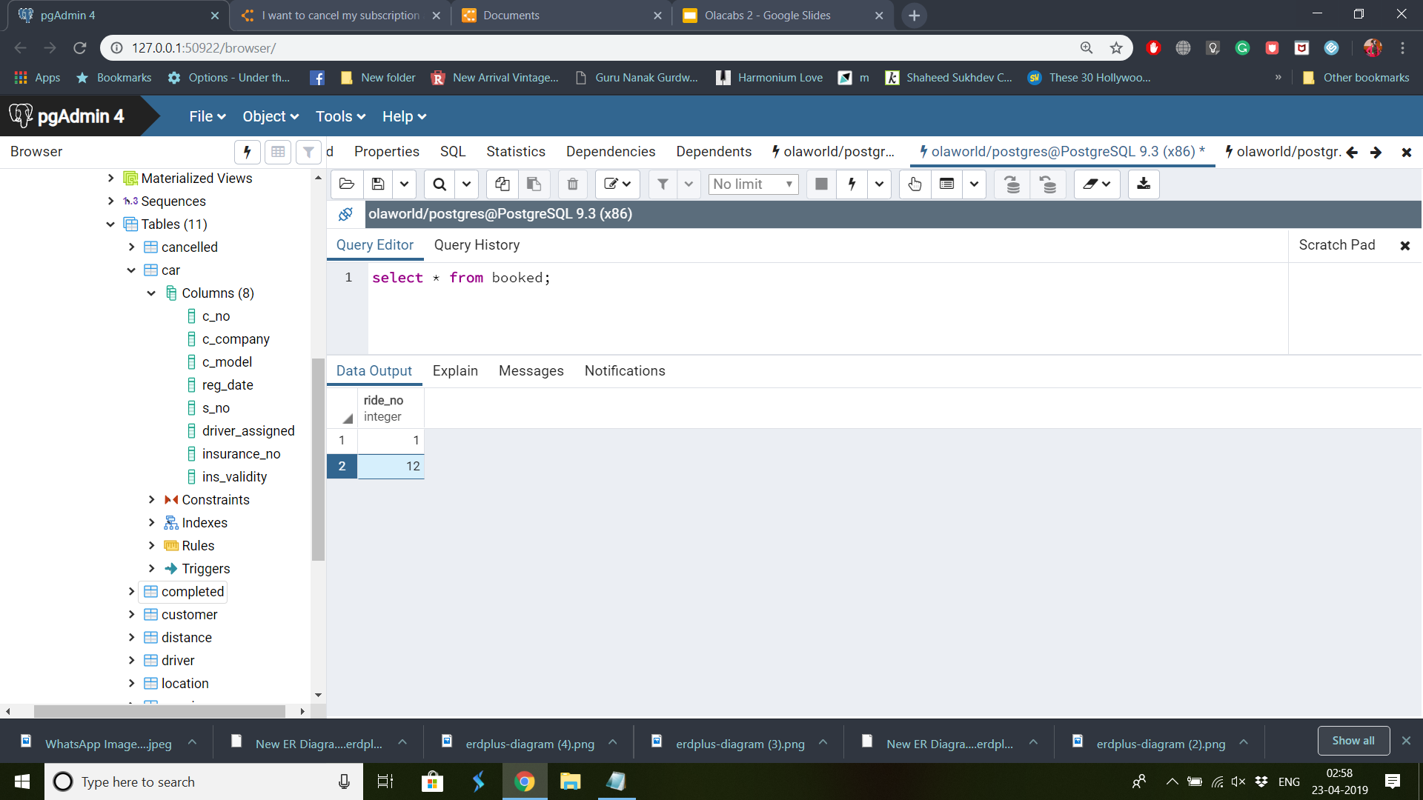
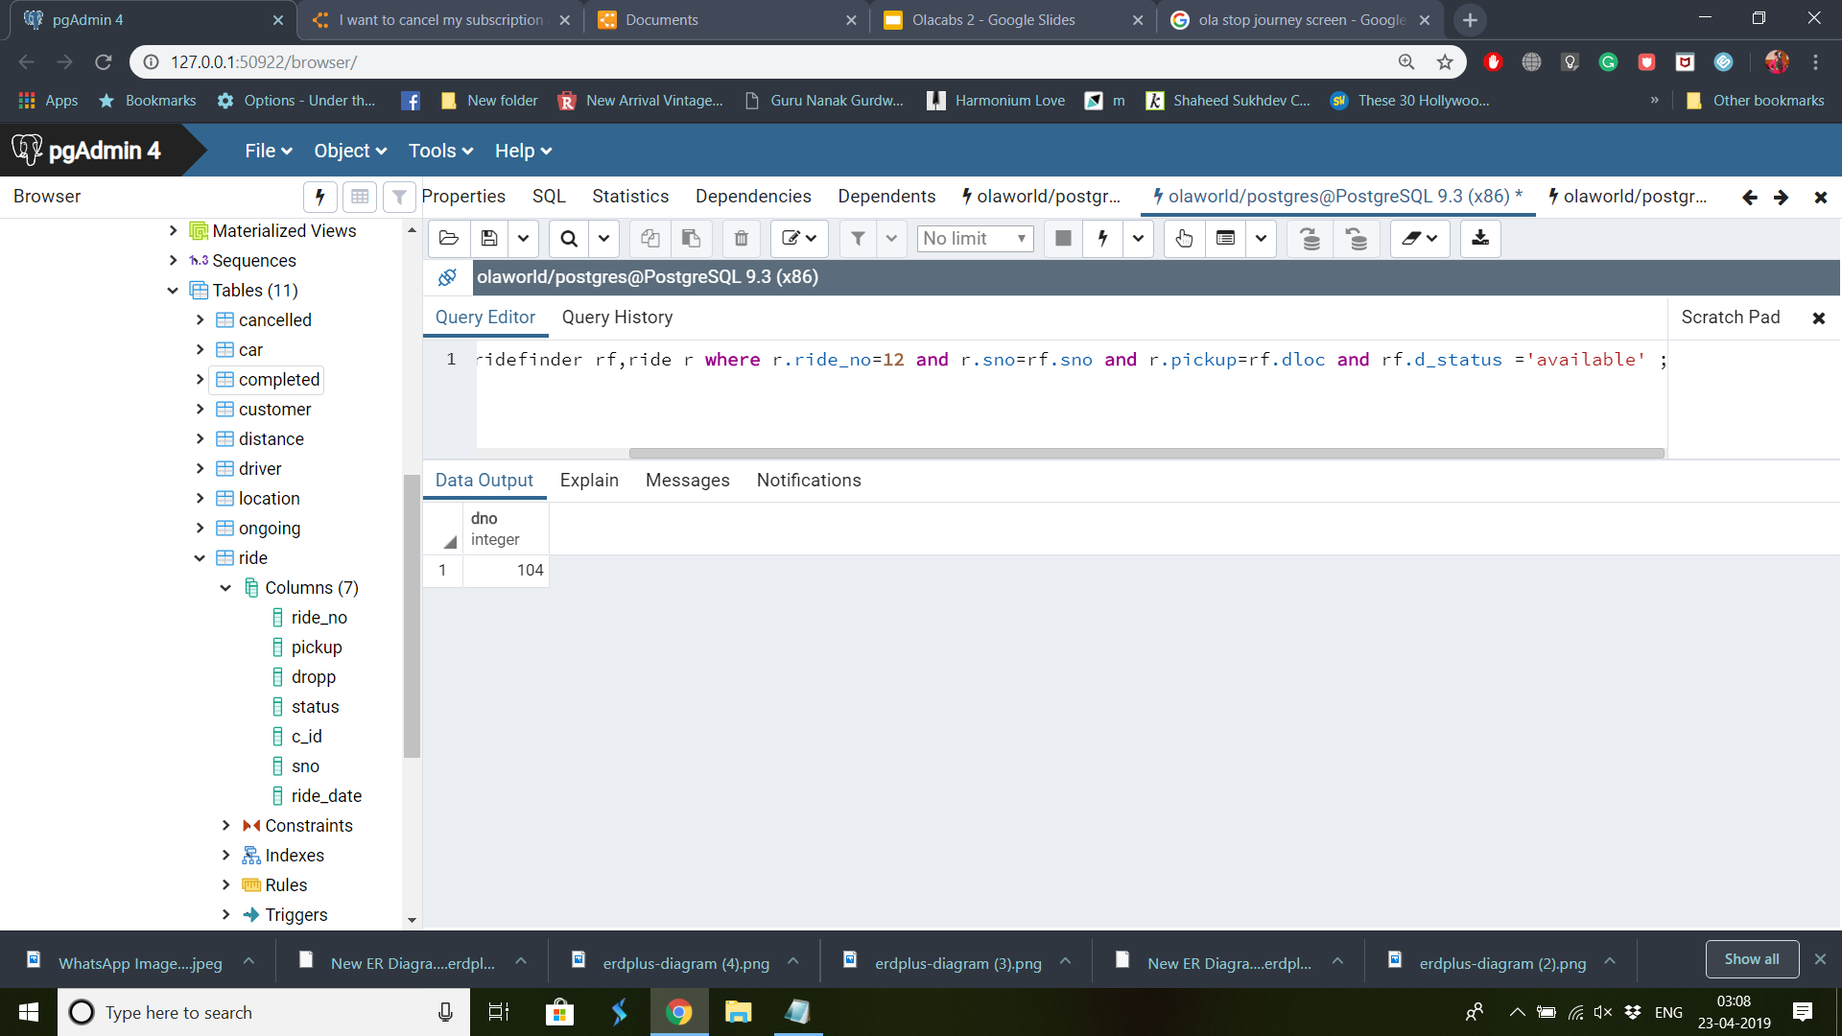
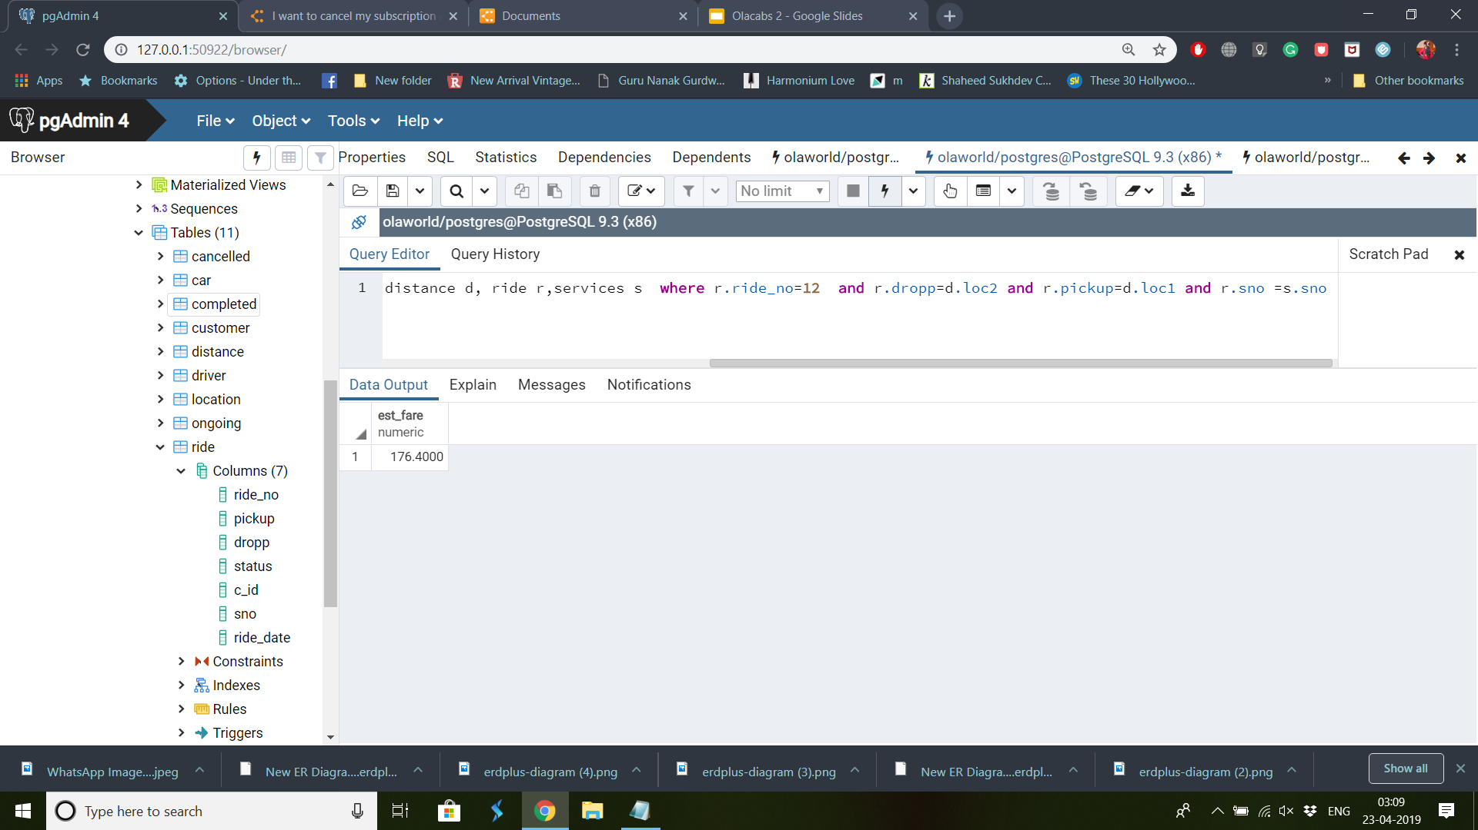
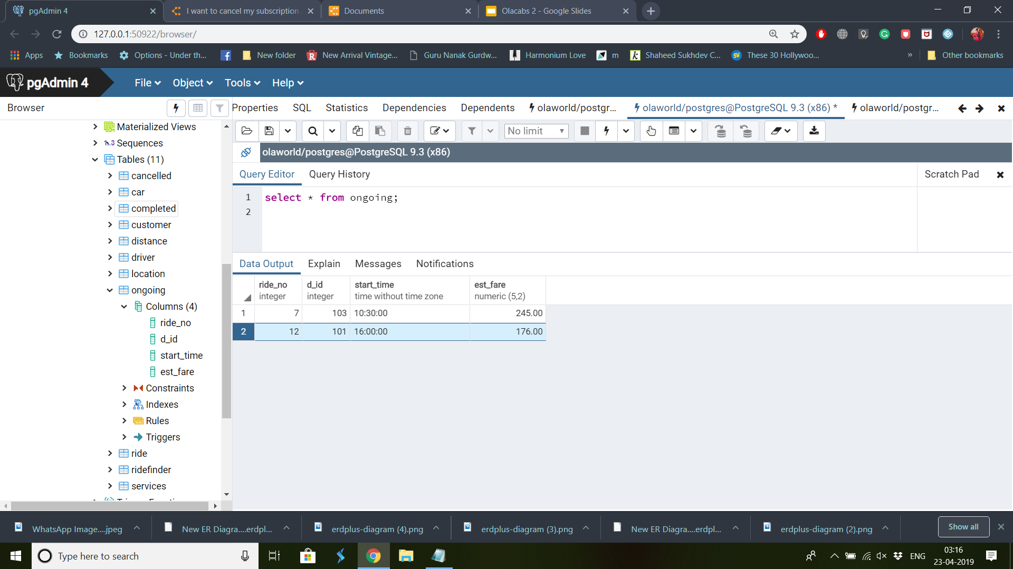

Slide 14
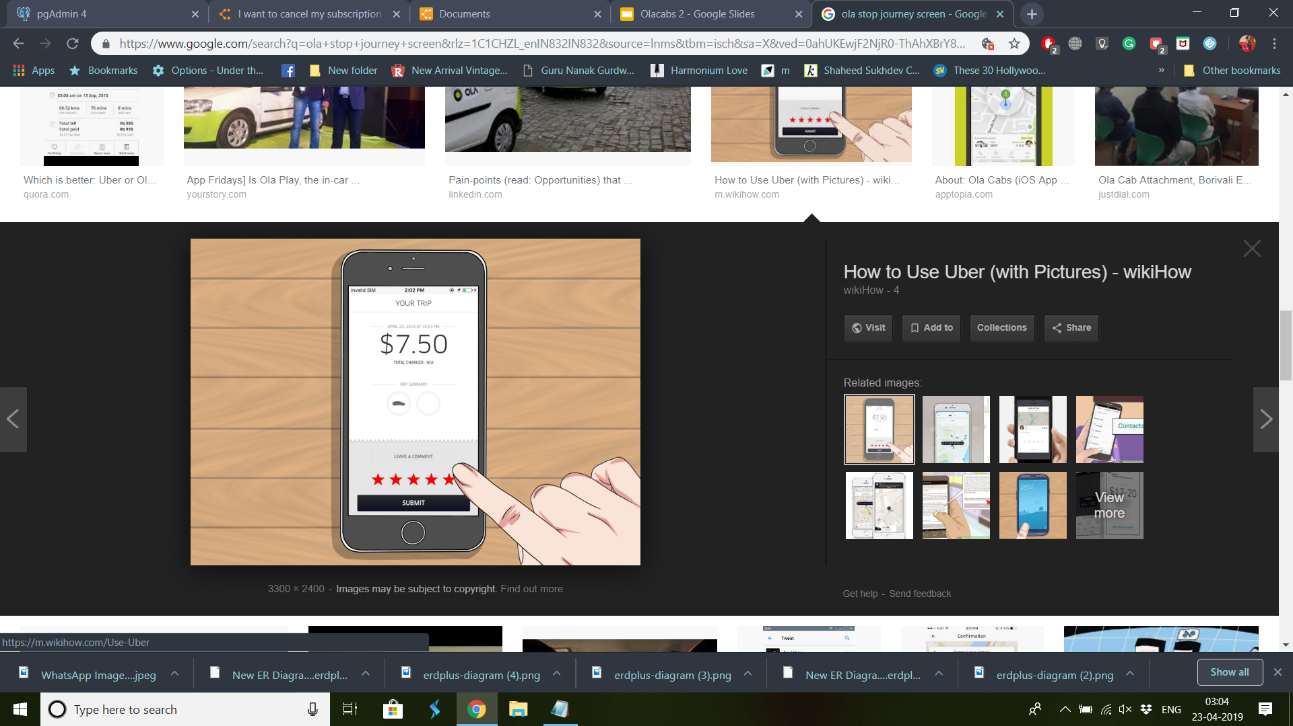
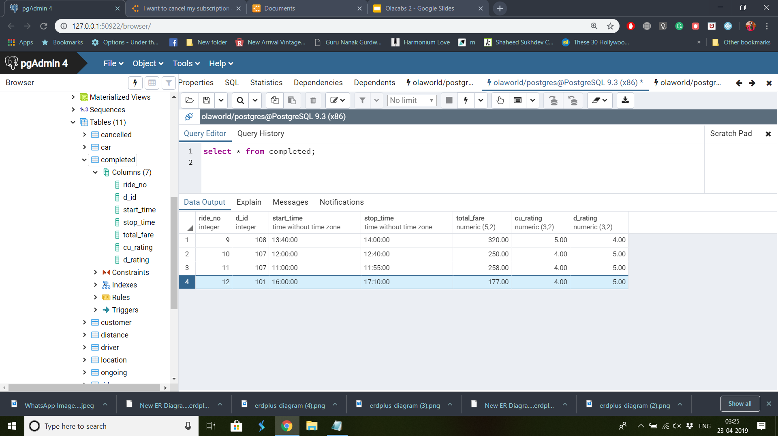


Slide 15
Queries on
OLA DATABASE

Slide 16
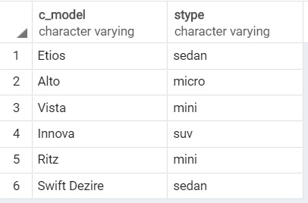
Finding types of cars allotted to each service
select distinct c.c_model,s.stype from car c inner join services s on s.sno=c.s_no;

Slide 17
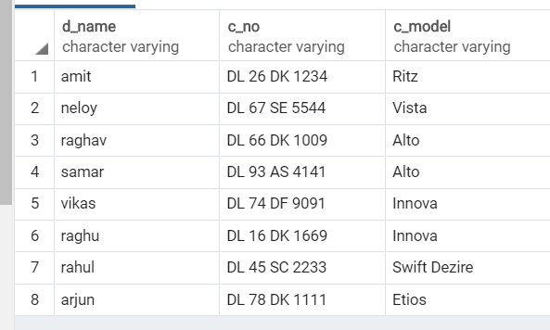
Finding car driven by each driver
select d.d_name, c.c_no,c.c_model from car c inner join driver d on c.driver_assigned=d.d_id;

Slide 18
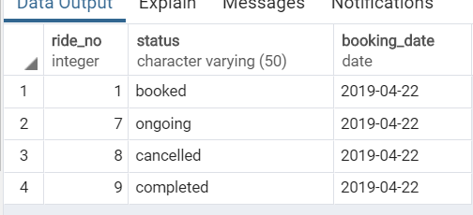
Checking status of all rides of 22 Apr’19
select r.ride_no,r.status from ride r where r.ride_date='2019-04-22';

Slide 19
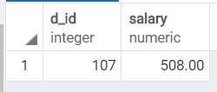
Calculating salary of a driver
select d_id,sum(total_fare) as salary from completed group by( d_id) having d_id=107;

Slide 20
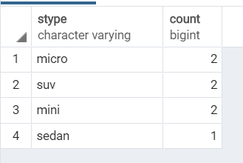
Finding number of available cars of each type in New Delhi
select stype,count (dno) from (select * from ridefinder rf inner join services s on rf.sno=s.sno) as cartype where d_status='available' group by (stype) ;

Slide 21
Android project
Show and explain your web, app or software projects using these gadget templates.
Place your screenshot here

Slide 22
iPhone project
Show and explain your web, app or software projects using these gadget templates.
Place your screenshot here

Slide 23
Tablet project
Show and explain your web, app or software projects using these gadget templates.
Place your screenshot here

Slide 24
Desktop project
Show and explain your web, app or software projects using these gadget templates.
Place your screenshot here

Slide 25
Thanks!

